Slide 1


Slotted Random-Access Wireless Network
TOMMASO BURLON
Francesco Iemma
Olgerti xhanej

Slide 2
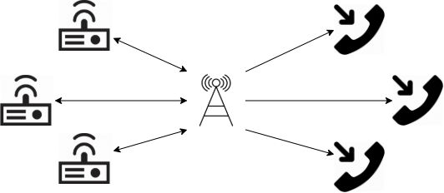
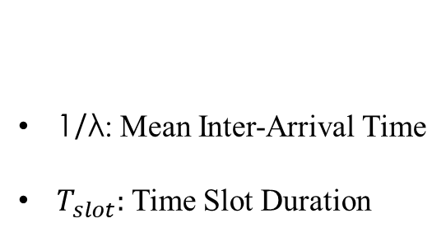
Modelling
General Assumptions
Slotted
Constant Packet Size
No Propagation Error
Unbounded Queues
Tx/Rx Synchronization
Collisions and Channel choice
N: Transmitter/Receiver Couples
C: Number of Channels
p: Sending Probability
1/λ: Mean Inter-Arrival Time
$T_{slot}:$ Time Slot Duration
Factors

Slide 3
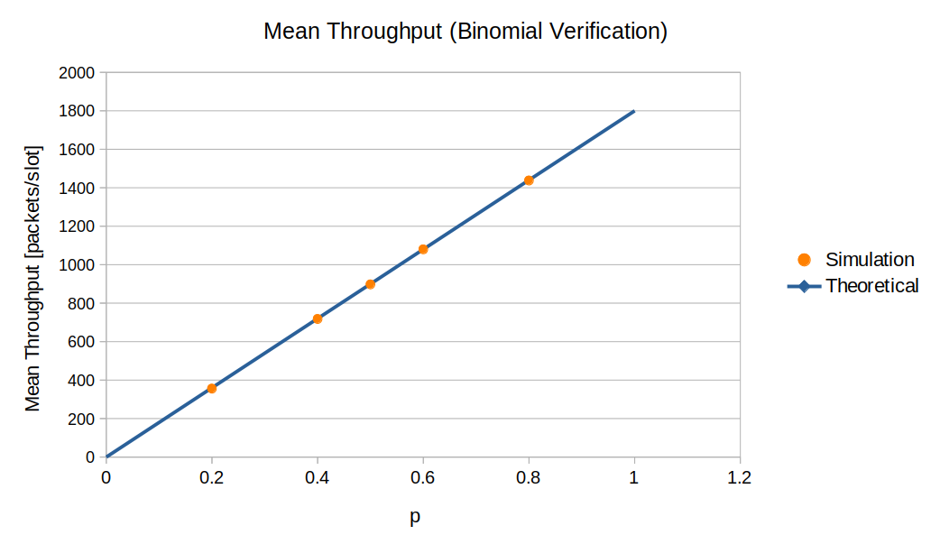
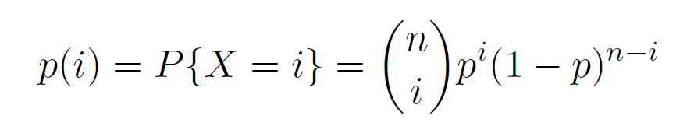
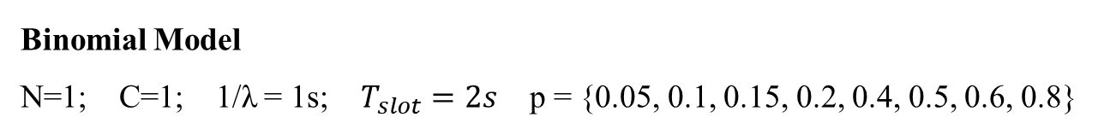
Verification (1)
Tests Performed
Continuity Test
Consistency Test
Degeneracy Test
Binomial Model
Collision Model
Binomial Model
N=1; C=1; 1/λ = 1s; $T_{slot}=2s$ p = {0.05, 0.1, 0.15, 0.2, 0.4, 0.5, 0.6, 0.8}

Slide 4
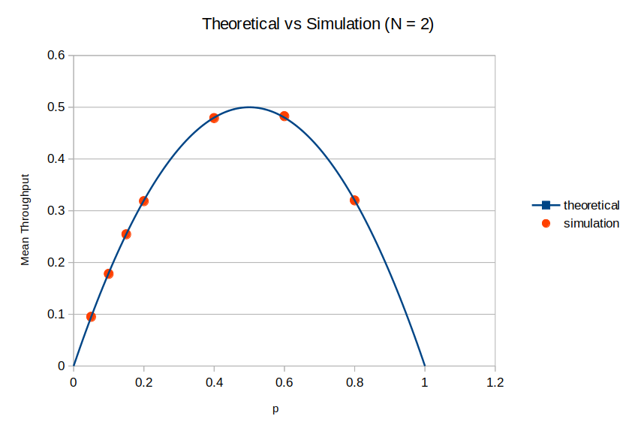
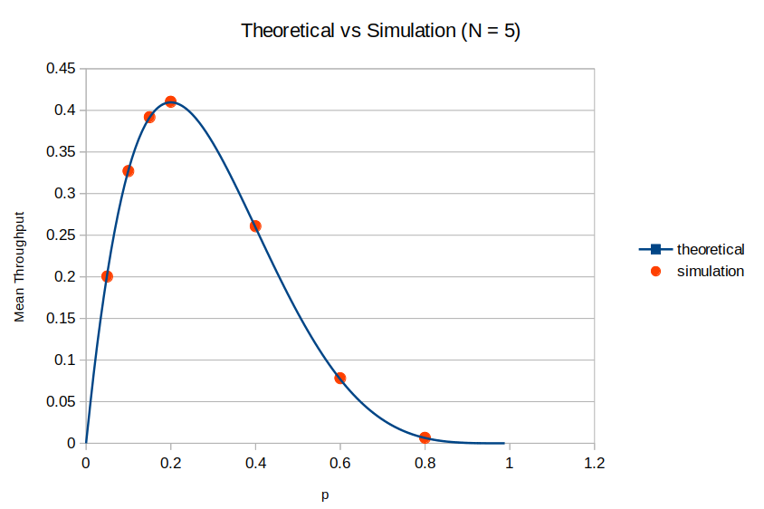

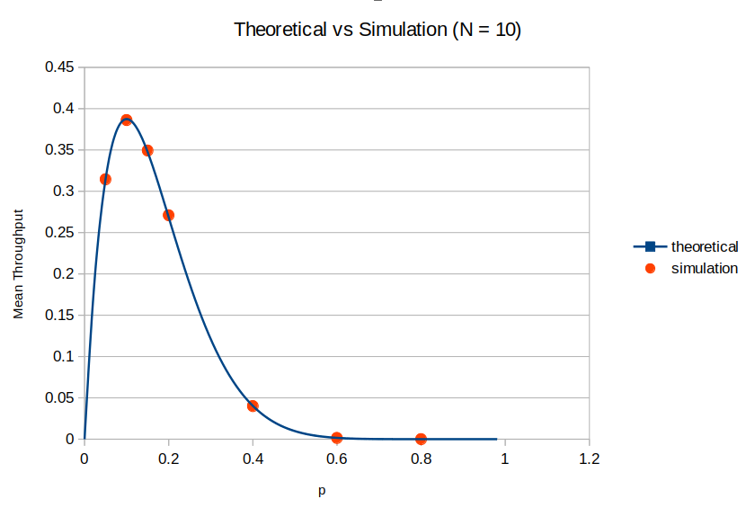
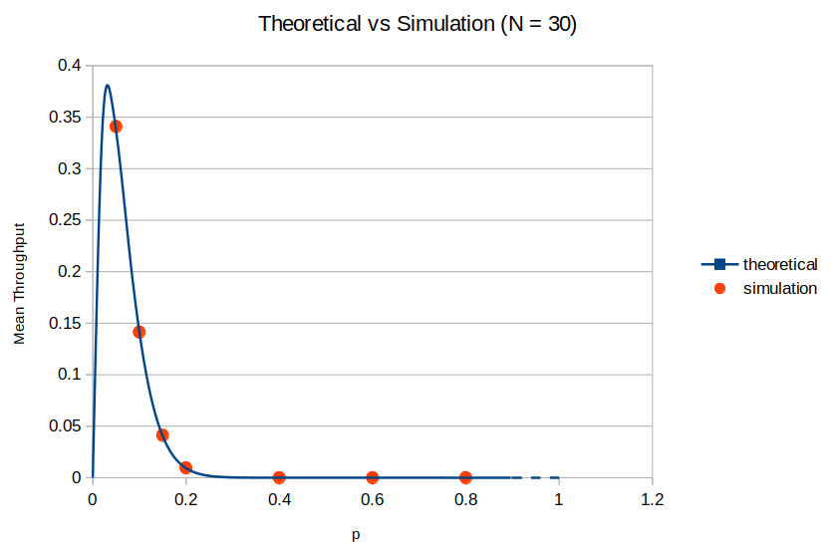

Verification (2)
Collision Model
The probability of a successfull transmission is equal to the probability that only one tx transmit, i.e.:
The latter can be seen as the mean throughput of the system in the single channel case:

Slide 5
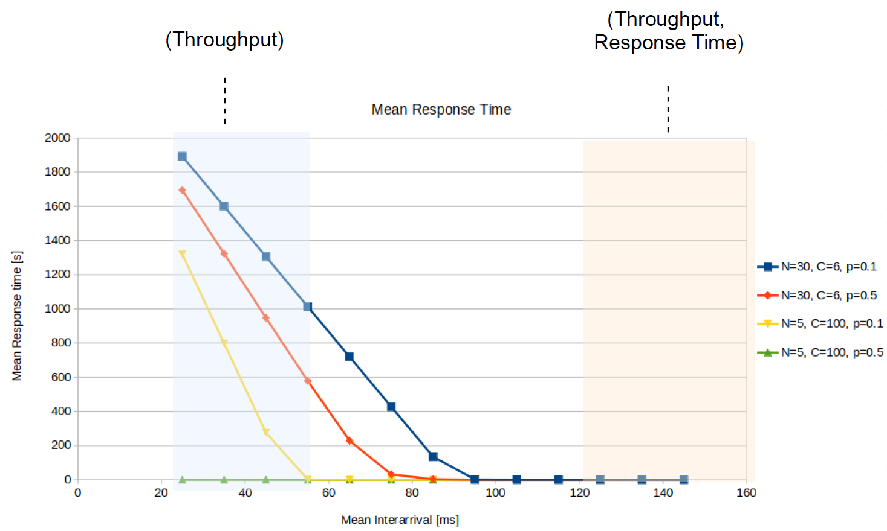
Response Time Limits

Slide 6
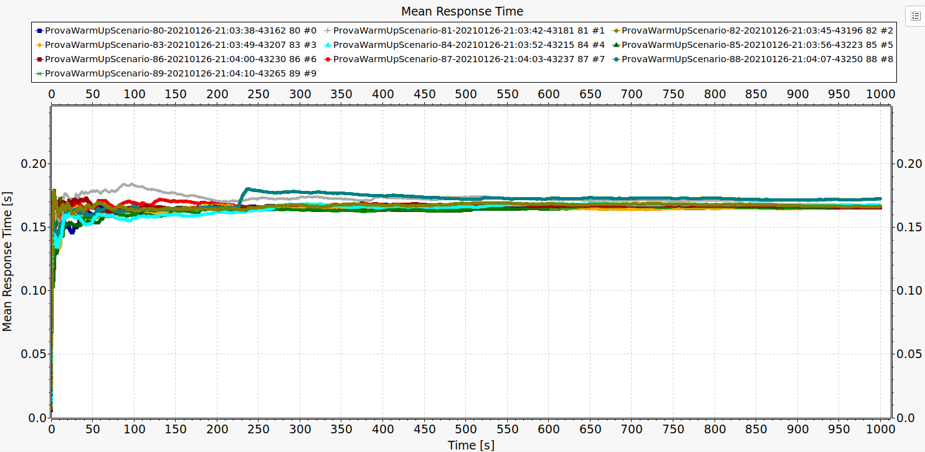
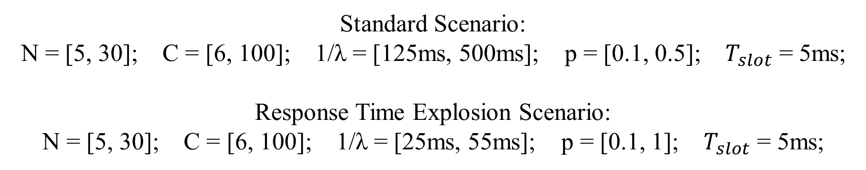
Scenario Calibration
WARMUP:
250s
SIMULATION DURATION:
5000s
Standard Scenario:
N = [5, 30]; C = [6, 100]; 1/λ = [125ms, 500ms]; p = [0.1, 0.5]; $T_{slot}$ = 5ms;
Response Time Explosion Scenario:
N = [5, 30]; C = [6, 100]; 1/λ = [25ms, 55ms]; p = [0.1, 1]; $T_{slot}$ = 5ms;

Slide 7
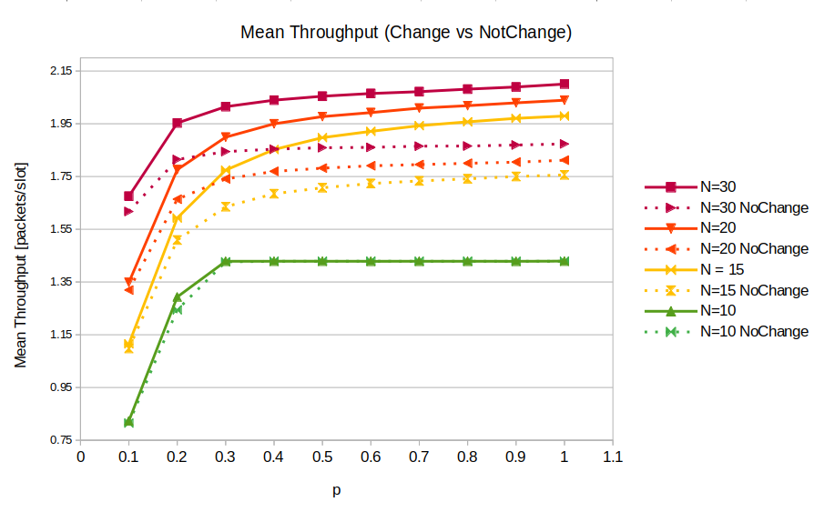
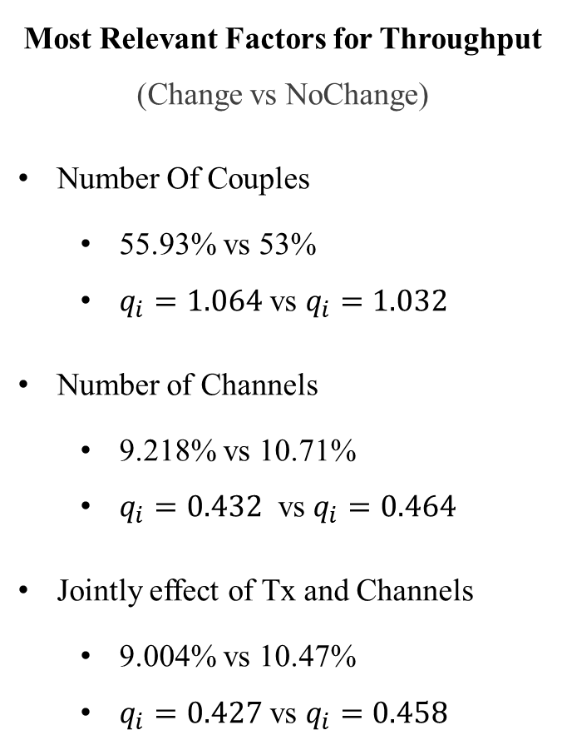
Response Time Explosion Scenario
Most Relevant Factors for Throughput
(Change vs NoChange)
Number Of Couples
55.93% vs 53%
$q_{i}=1.064$ vs $q_{i}=1.032$
Number of Channels
9.218% vs 10.71%
$q_{i}=0.432$ vs $q_{i}=0.464$
Jointly effect of Tx and Channels
9.004% vs 10.47%
$q_{i}=0.427$ vs $q_{i}=0.458$

Slide 8
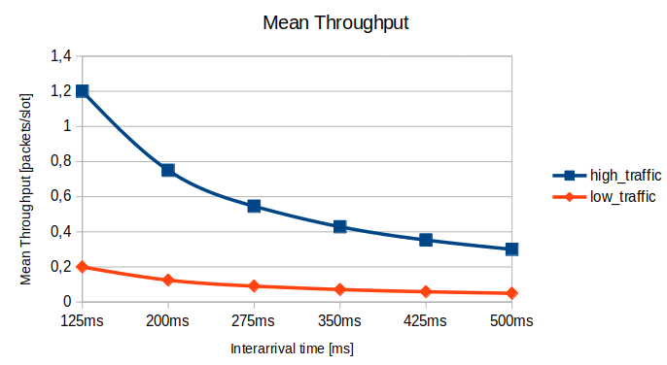
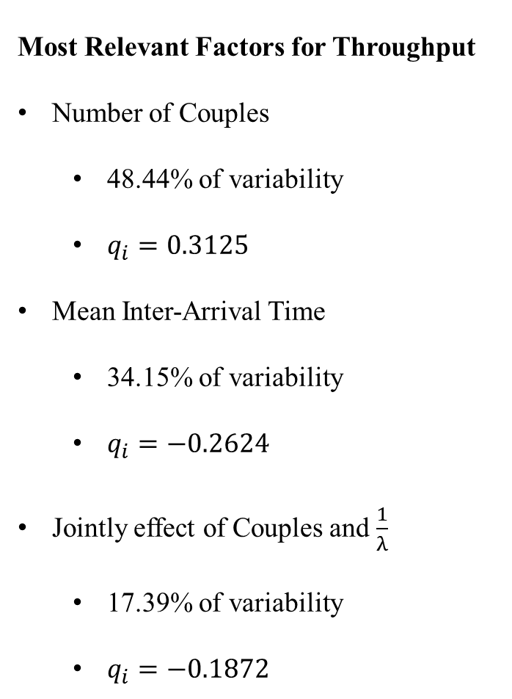
Standard Scenario - Throughput
Most Relevant Factors for Throughput
Number of Couples
48.44% of variability
$q_{i}=0.3125$
Mean Inter-Arrival Time
34.15% of variability
$q_{i}=−0.2624$
Jointly effect of Couples and $\frac{1}{λ}$
17.39% of variability
$q_{i}=−0.1872$
High Traffic Scenario
N = 30; C = 6; p = 0.1
Low Traffic Scenario
N = 5; C = 100; p=0.1

Slide 9
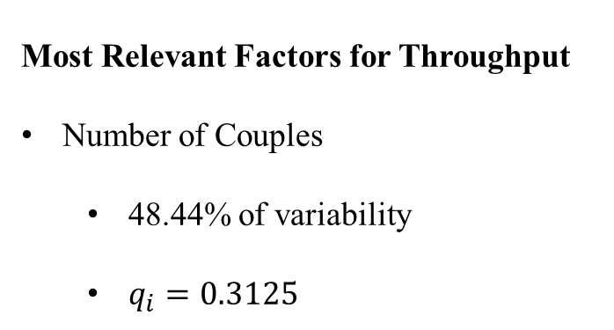
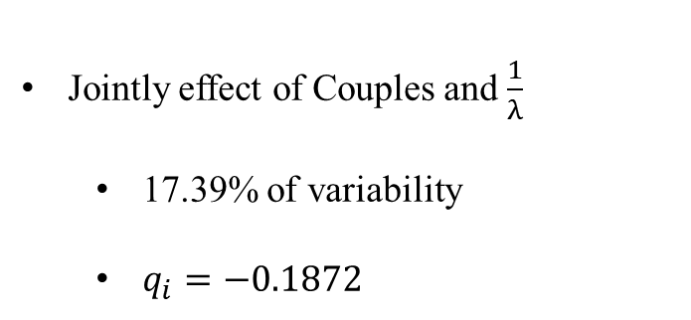

Standard Scenario - Throughput
Most Relevant Factors for Throughput
Number of Couples
48.44% of variability
$q_{i}=0.3125$
Mean Inter-Arrival Time
34.15% of variability
$q_{i}=−0.2624$
Jointly effect of Couples and $\frac{1}{λ}$
17.39% of variability
$q_{i}=−0.1872$
High Traffic Scenario
N = 30; C = 6; p = 0.1
Low Traffic Scenario
N = 5; C = 100; p=0.1

Slide 10
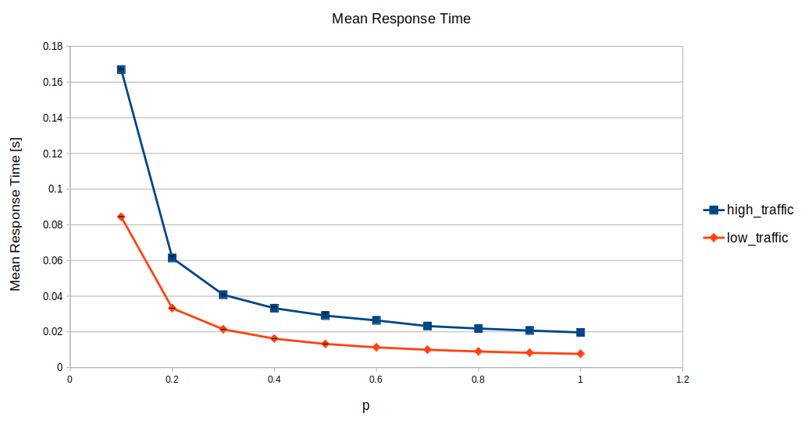
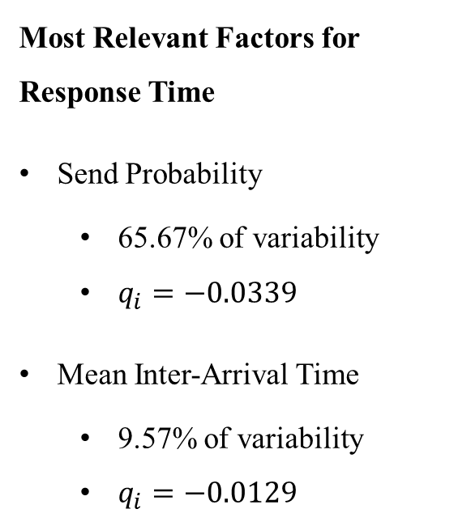
Standard Scenario – Response Time
Most Relevant Factors for Response Time
Send Probability
65.67% of variability
$q_{i}=−0.0339$
Mean Inter-Arrival Time
9.57% of variability
$q_{i}=−0.0129$
High Traffic Scenario: N = 30; C = 6; 1/λ = 125ms
Low Traffic Scenario: N = 5; C = 100; 1/λ = 125ms

Slide 11
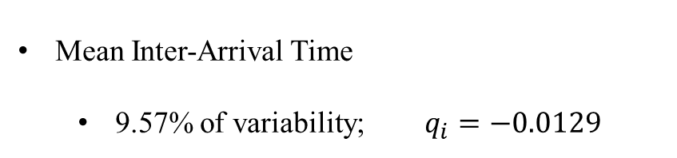
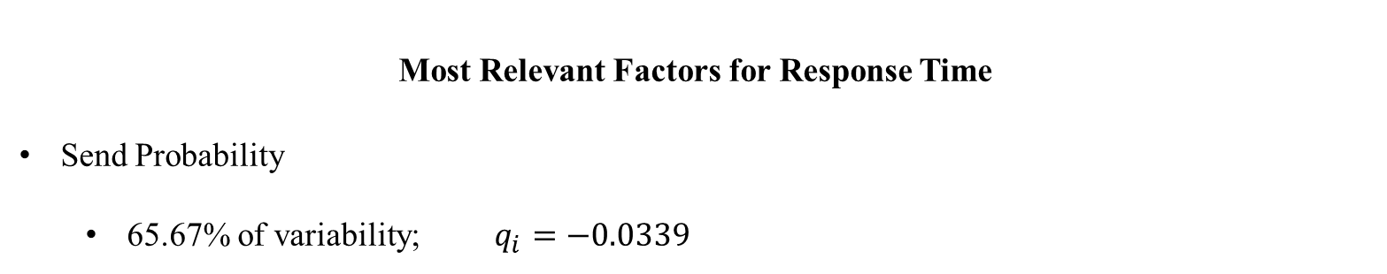
Standard Scenario – Response Time
Most Relevant Factors for Response Time
Send Probability
65.67% of variability; $q_{i}=−0.0339$
Mean Inter-Arrival Time
9.57% of variability; $q_{i}=−0.0129$
High Traffic Scenario
N = 30; C = 6; 1/λ = 125ms
Low Traffic Scenario
N = 5; C = 100; 1/λ = 125ms

Slide 12
Conclusions
No-Change of Channel Sub-Scenario is worst
An high send probability is always better
The Throughput depends heavily from the traffic and from the mean inter-arrival time
The higher the mean inter-arrival time the lower the throughput and the lower the response time

Slide 13
SLIDES ULTERIORI

Slide 14
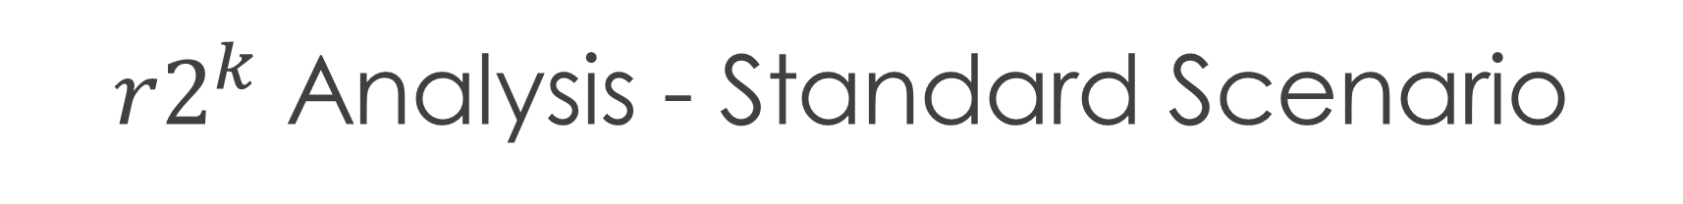
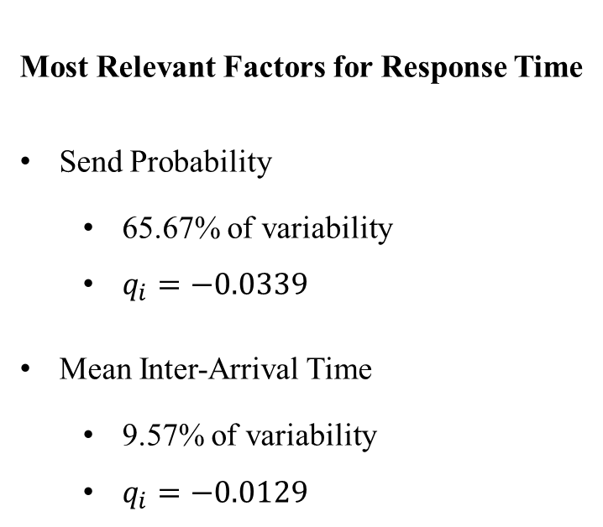
$r2^{k}$ Analysis - Standard Scenario
Most Relevant Factors for Throughput
Number of Couples
48.44% of variability
$q_{i}=0.3125$
Mean Inter-Arrival Time
34.15% of variability
$q_{i}=−0.2624$
Jointly effect of Couples and $\frac{1}{λ}$
17.39% of variability
$q_{i}=−0.1872$
Most Relevant Factors for Response Time
Send Probability
65.67% of variability
$q_{i}=−0.0339$
Mean Inter-Arrival Time
9.57% of variability
$q_{i}=−0.0129$

Slide 15
Standard Scenario
High Traffic Scenario
N = 30; C = 6; 1/λ = 125ms
Low Traffic Scenario
N = 5; C = 100; 1/λ = 125ms
High Traffic Scenario
N = 30; C = 6; p = 0.1
Low Traffic Scenario
N = 5; C = 100; p=0.1

Slide 16
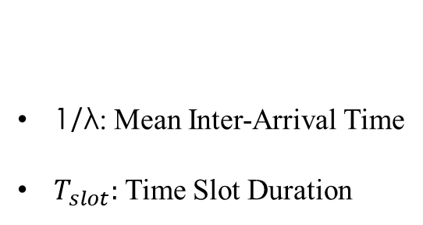
Modelling
General Assumptions
Slotted
Constant Packet Size
No Propagation Error
Unbounded Queues
Tx/Rx Synchronization
Collisions and Channel choice
N: Transmitter/Receiver Couples
C: Number of Channels
p: Sending Probability
1/λ: Mean Inter-Arrival Time
$T_{slot}:$ Time Slot Duration
Factors

Slide 17
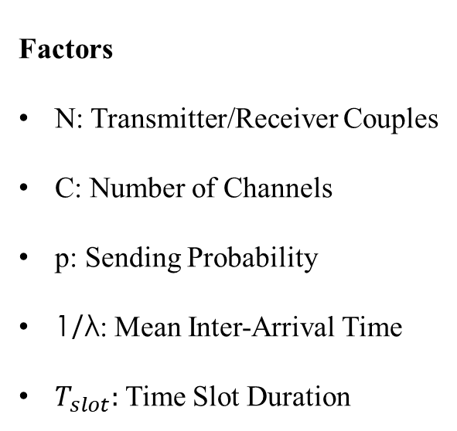
Modelling
General Assumptions
Slotted
Constant Packet Size
No Propagation Error
Unbounded Queues
Tx/Rx Synchronization
Collisions and Channel choice
Factors
N: Transmitter/Receiver Couples
C: Number of Channels
p: Sending Probability
1/λ: Mean Inter-Arrival Time
$T_{slot}:$ Time Slot Duration

Slide 18
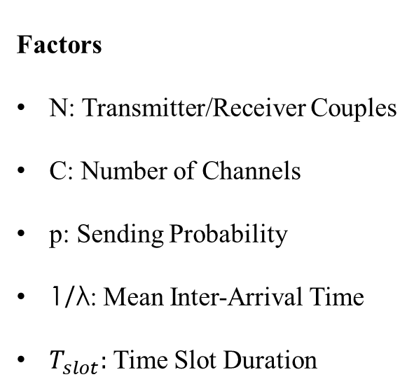
Modelling
General Assumptions
Slotted
Constant Packet Size
No Propagation Error
Unbounded Queues
Tx/Rx Synchronization
Collisions and Channel choice
KPI
Throughput
Response Time
Factors
N: Transmitter/Receiver Couples
C: Number of Channels
p: Sending Probability
1/λ: Mean Inter-Arrival Time
$T_{slot}:$ Time Slot Duration

Slide 19
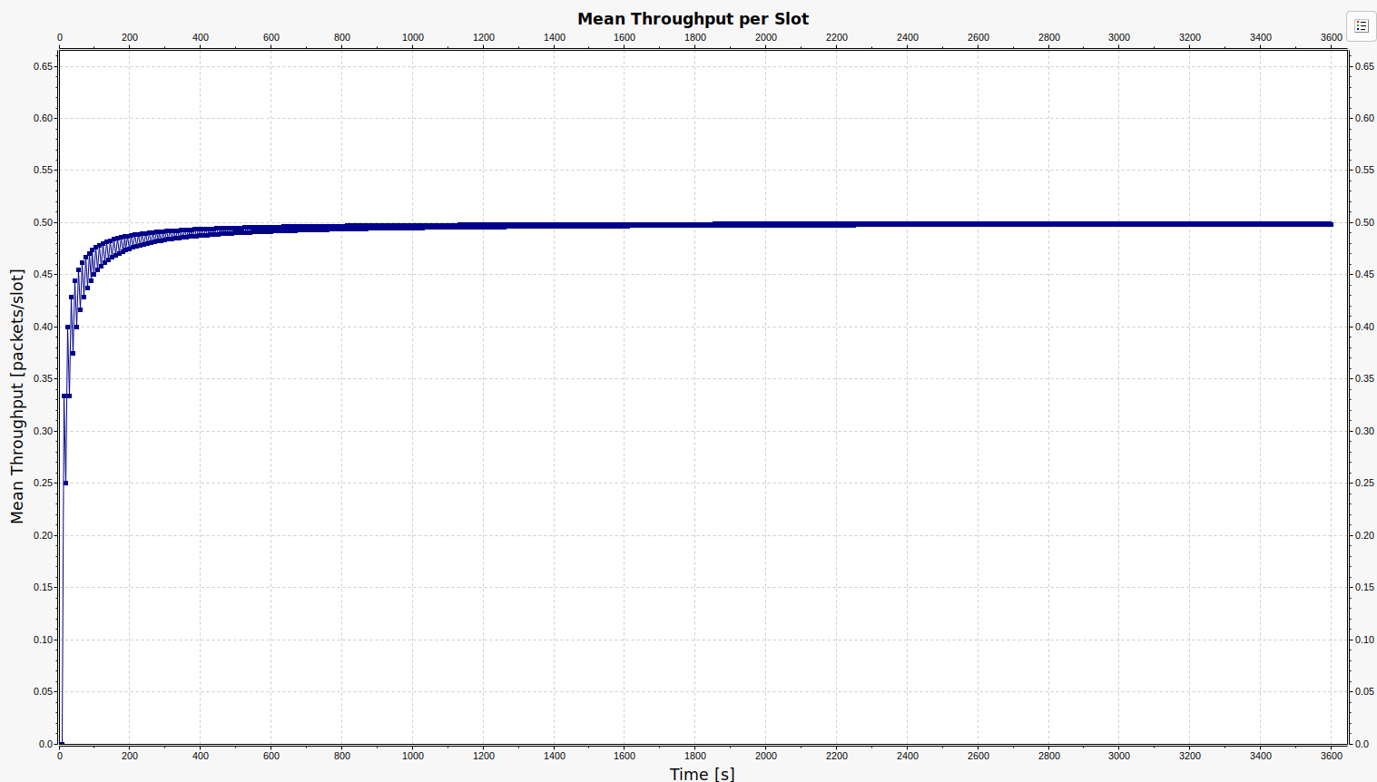
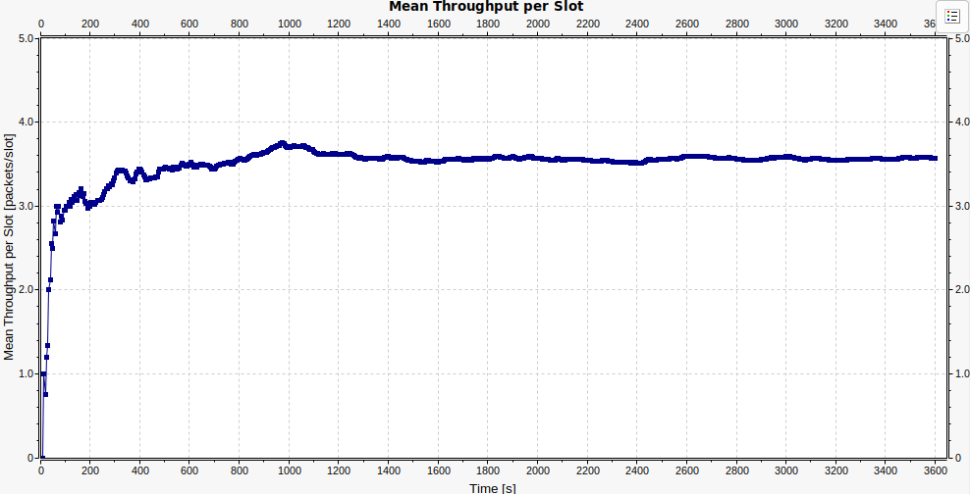
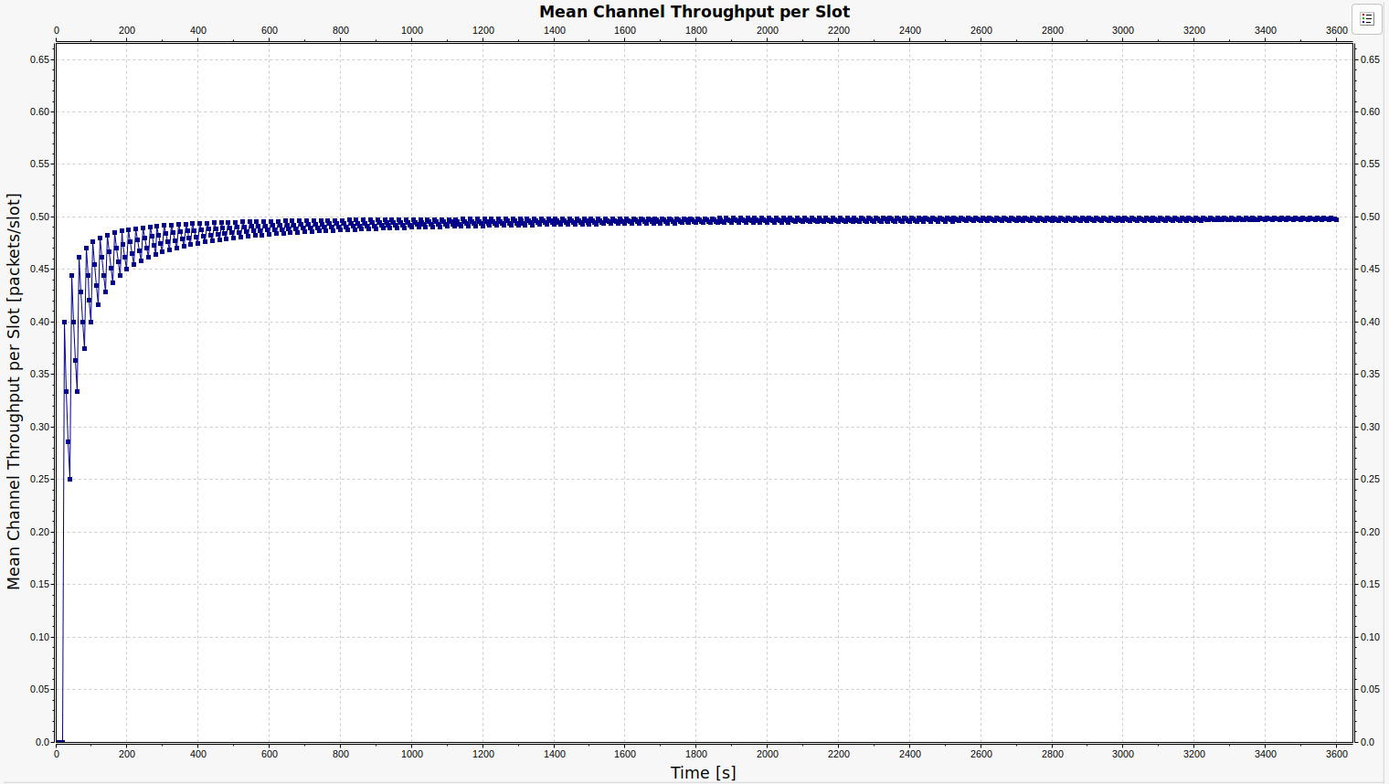
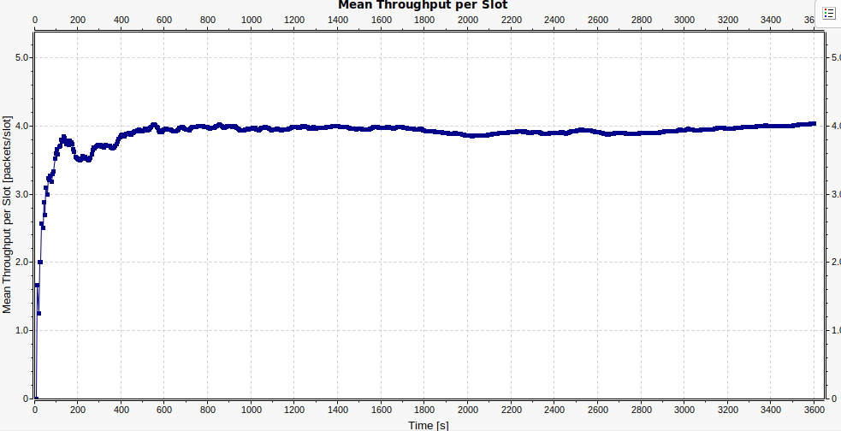
Verification (1)
Consistency Test
Continuity Test
N=1; C=500; p=1; 1/λ= 10s (deterministic);$T_{slot}$=5s
N=8; C=20; p=1; 1/λ= 10s (deterministic);$T_{slot}$=5s
N=2; C=500; p=1; 1/λ= 20s (deterministic);$T_{slot}$=5s
N=10; C=20; p=1; 1/λ= 10s (deterministic);$T_{slot}$=5s

Slide 20
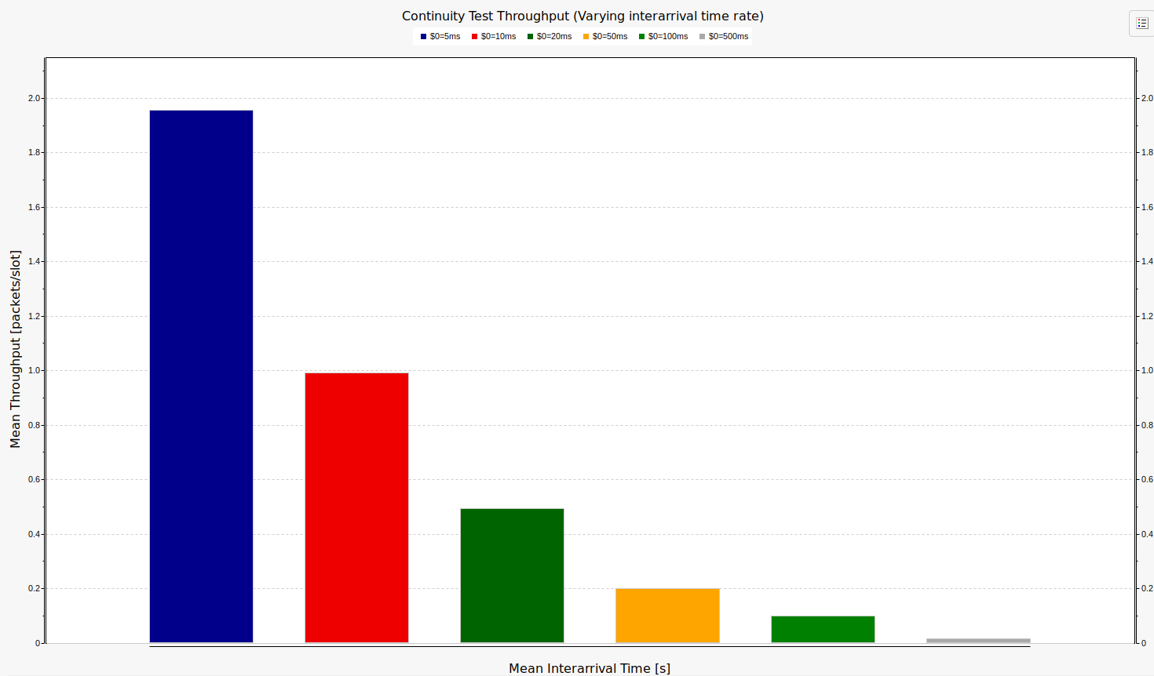
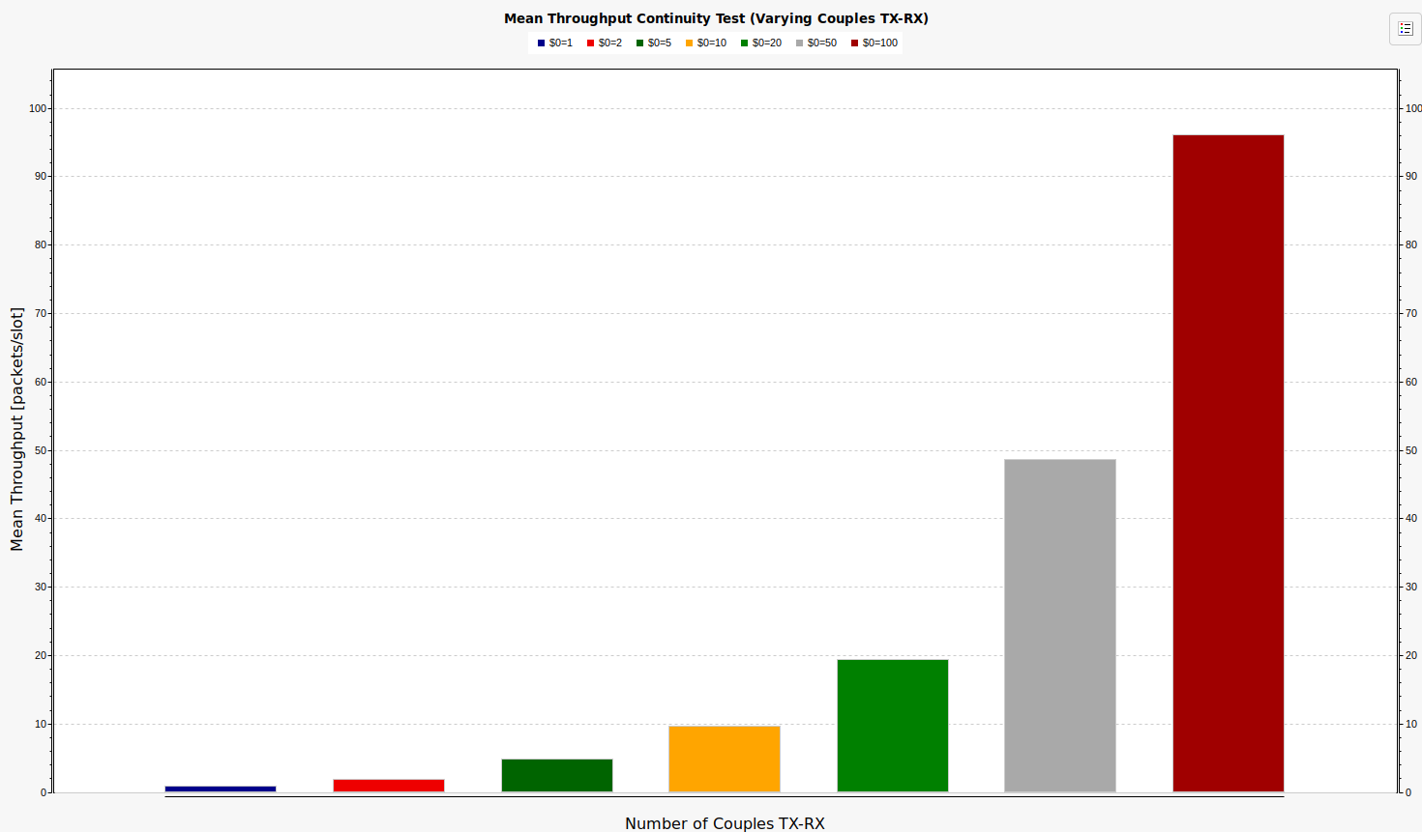
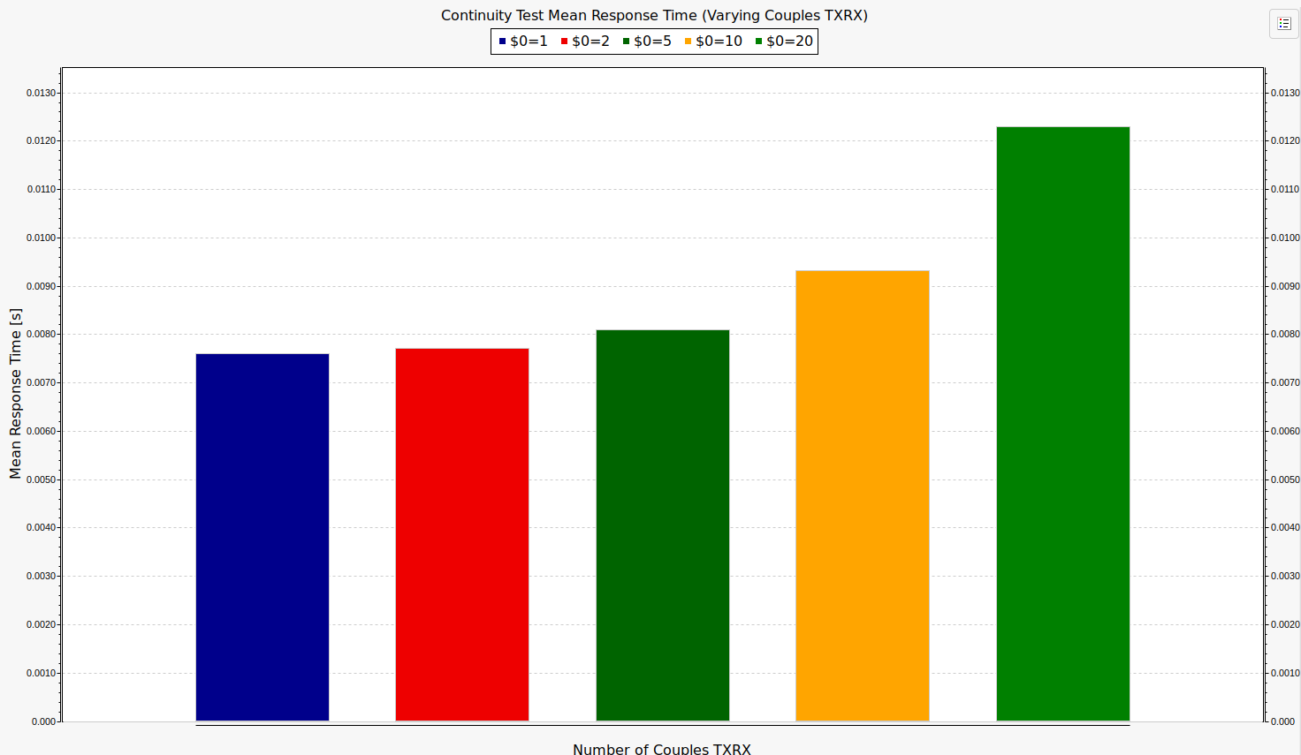
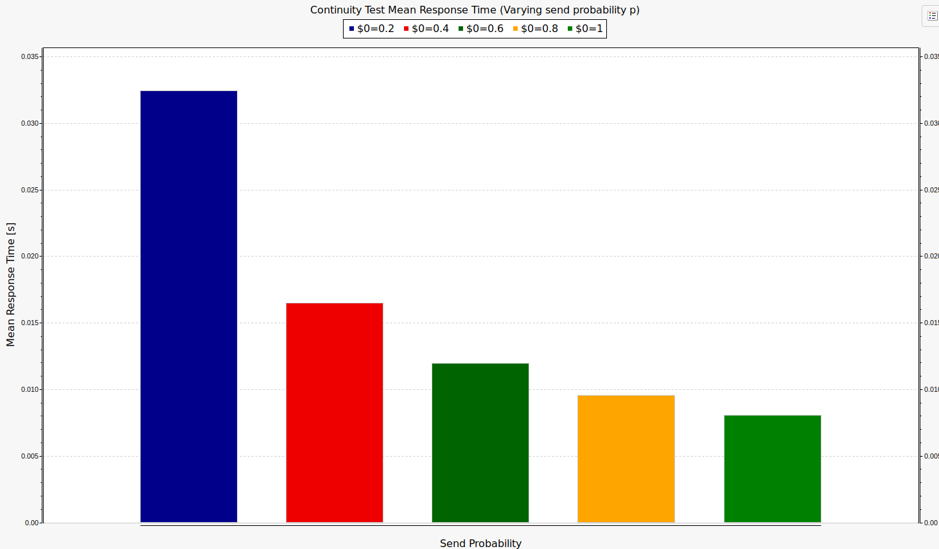
Verification (2)
KPI Monotonicity

Slide 21
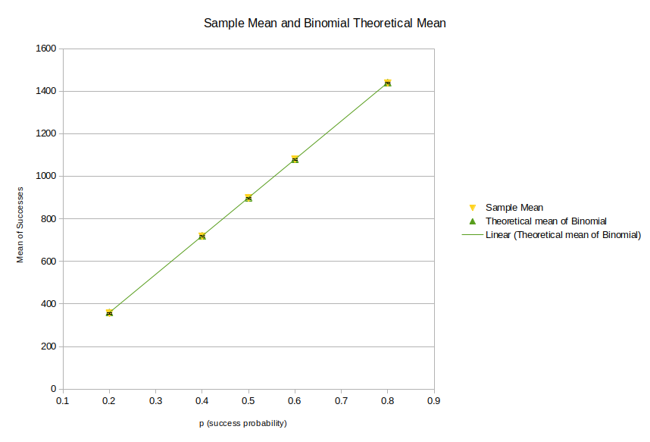
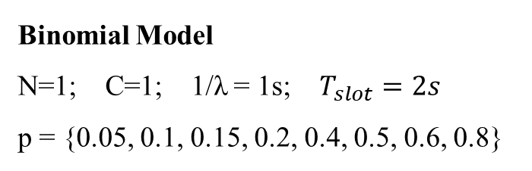
Verification (3)
Binomial Model
N=1; C=1; 1/λ = 1s; $T_{slot}=2s$
p = {0.05, 0.1, 0.15, 0.2, 0.4, 0.5, 0.6, 0.8}
Binomial Model And Collisions

Slide 22
Throughput Study
High Traffic Scenario
N = 30; C = 6; p = 0.1
Low Traffic Scenario
N = 5; C = 100; p=0.1

Slide 23
Response Time Study
High Traffic Scenario
N = 30; C = 6; 1/λ = 125ms
Low Traffic Scenario
N = 5; C = 100; 1/λ = 125ms

Slide 24
Response Time Explosion Scenario

